Slide 1
Advanced Crime Detection and Punishment Reward Prediction

Slide 2
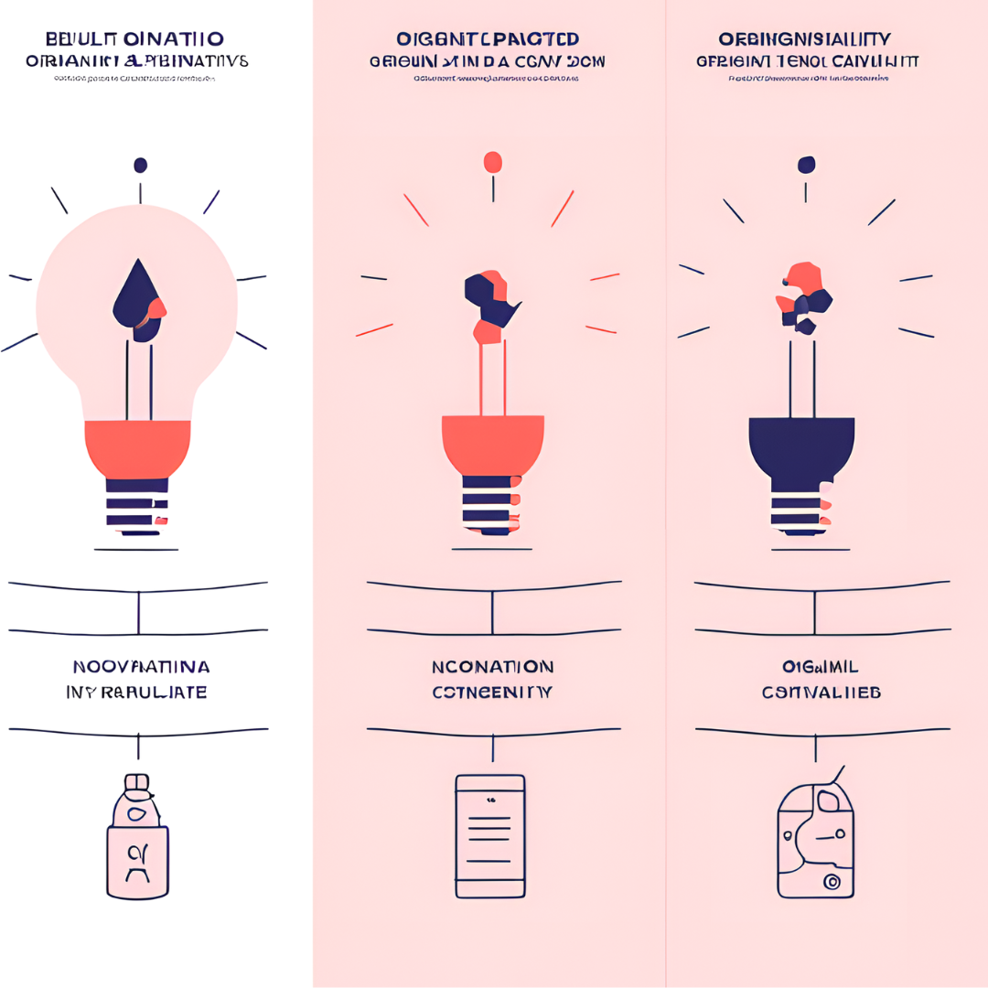
Objectives

Slide 3

Are you aware of our Laws?

Slide 4

How many sections are
in Indian IPC?

Slide 5
Introduction
Welcome to the Advanced Crime Detection and Predictive Punishment Application presentation. We will explore the cutting-edge technologies and methodologies for crime detection and predictive punishment. This is an innovative application for finding our rights, laws and als we take actions based on others behviour

Slide 6

Crime Analysis
Utilizing big data and machine learning, our application can analyze complex crime patterns and identify potential hotspots for criminal activities. This enables proactive law enforcement actions. The user can enter the crime as a input. The ML algorithm will process the user input.

Slide 7

Our application employs sophisticated algorithms to create predictive models for criminal behavior. By analyzing various factors, it can forecast punishment reward with high accuracy.

Slide 8
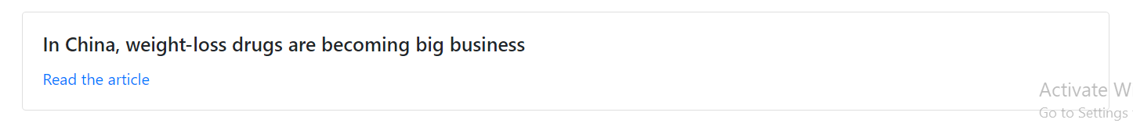
Also our application will print the related news based the punishment reward. News will be collected from different source, posted on Internet
Example:

Slide 9
Punishment by Rewards
Based on the User input, after preprocessing of data, punishment of every crime will be predicted with sections. Also related punishment will be printed as as separate entity

Slide 10
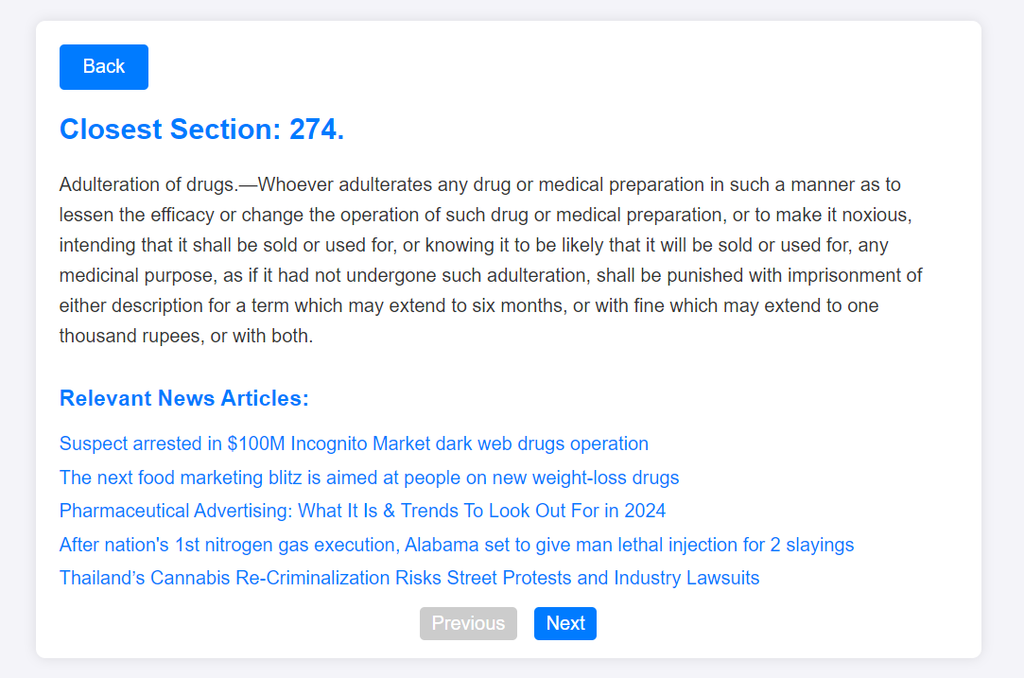

Slide 11

Innovation
and
Originality

Slide 12

Relevance to
Current Issues

Slide 13

Technical
Merit

Slide 14

Comprehensive
Background
Research

Slide 15

Future Scope
and
Scalability

